Slide 1
Datacaptatie & visualisatie
Node-RED Dashboarding

Slide 2
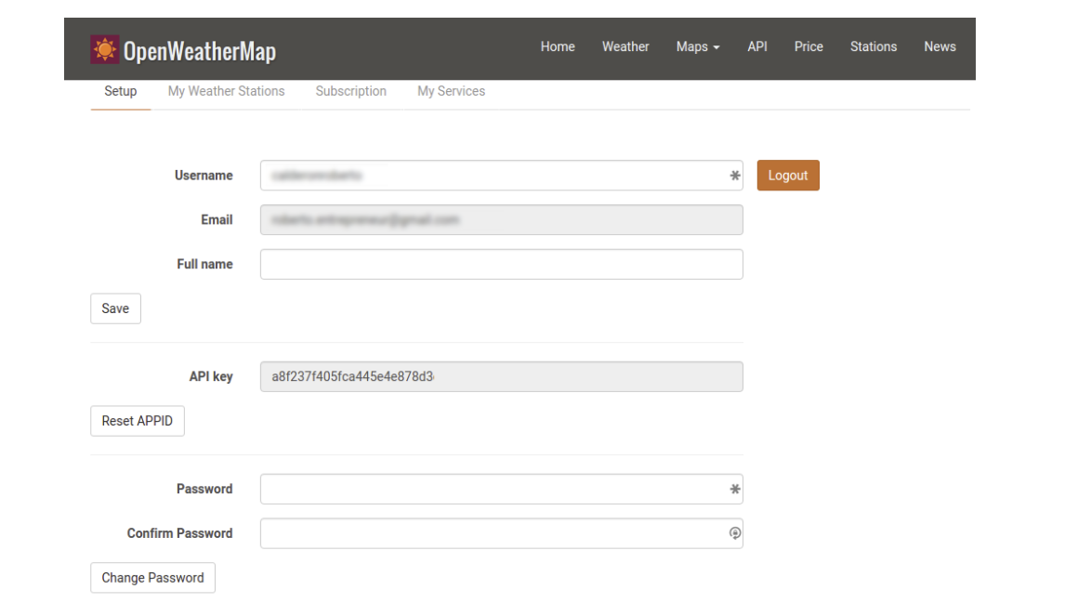
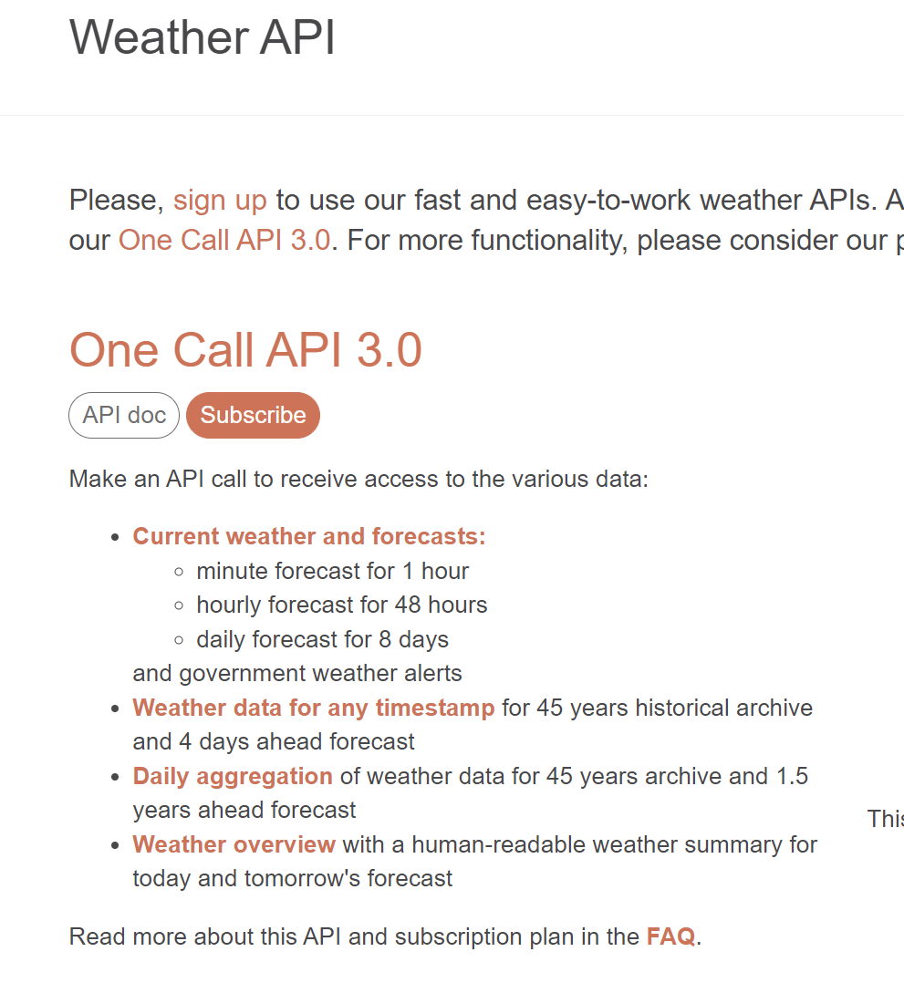
Exercise : openweather
Create an account => we can use the openweather api
It can take an hour before your account is activated
https://openweathermap.org/api

Slide 3
WEB API
A Web API (Application Programming Interface) is a set of rules and protocols that allows different software applications to communicate with each other over the web.
Intermediary Role: Acts as an intermediary between different applications, enabling them to exchange data and perform tasks seamlessly.
HTTP Protocol: Typically accessed using HTTP protocols.
Types of Web APIs:
Browser APIs: Extend the functionality of web browsers (e.g., Web Audio,Geolocation).
Server APIs: Extend the functionality of web servers.
Common Uses:
Integrating third-party services (e.g., Google Maps API).
Building RESTful services

Slide 4
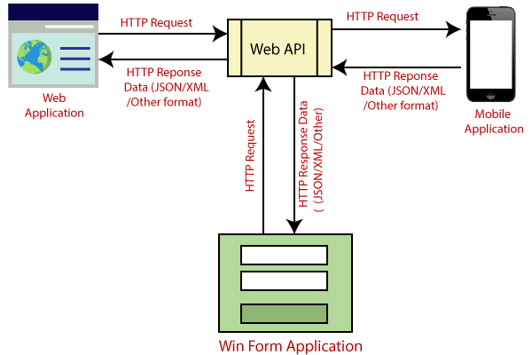
WEB API

Slide 5
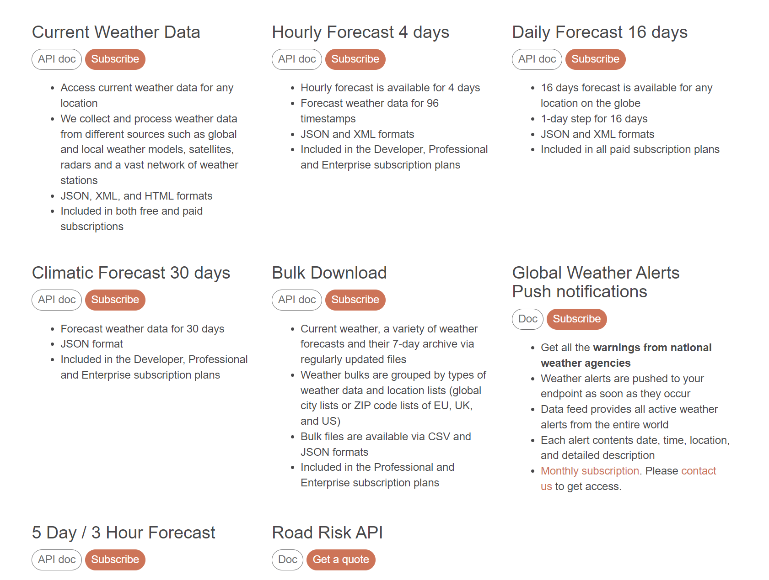
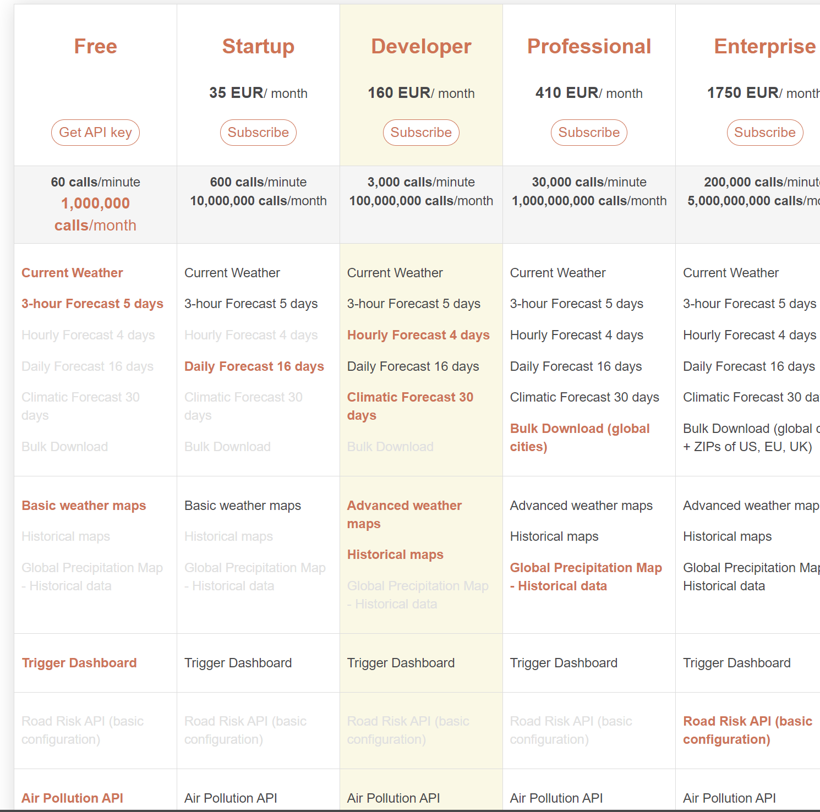
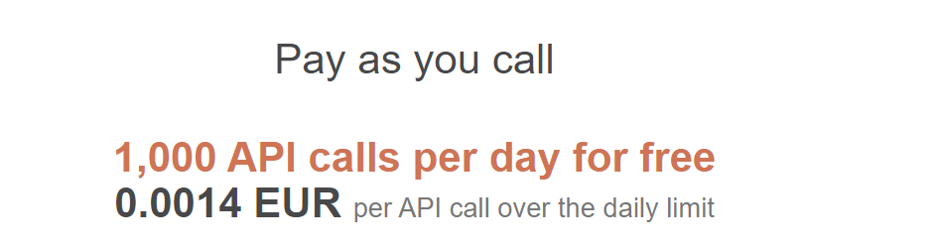
WEB API

Slide 6
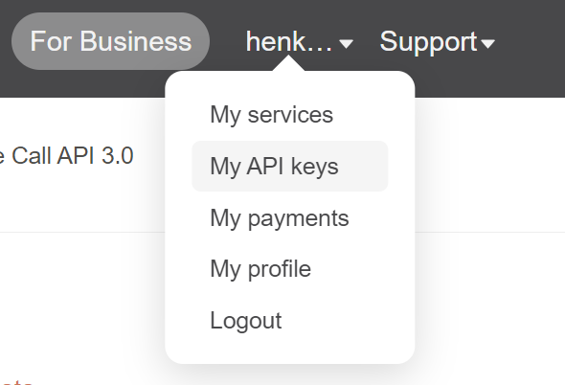
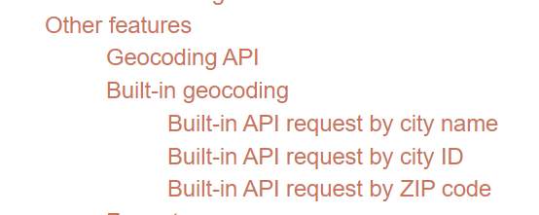
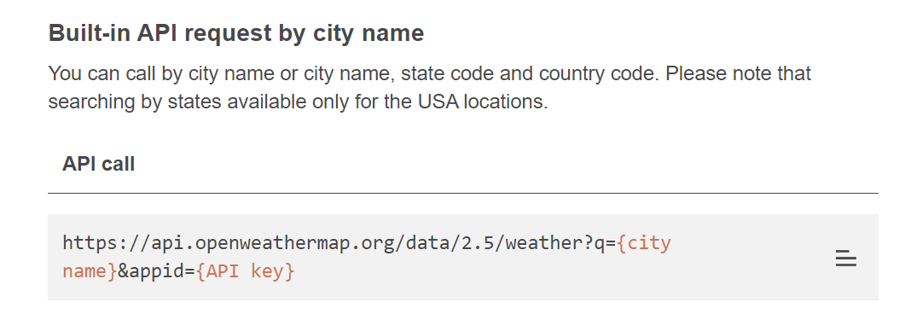
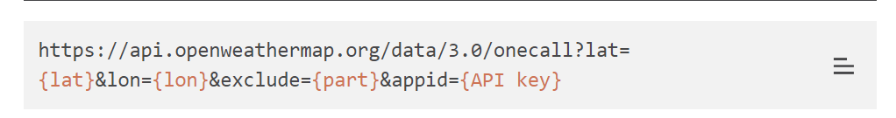
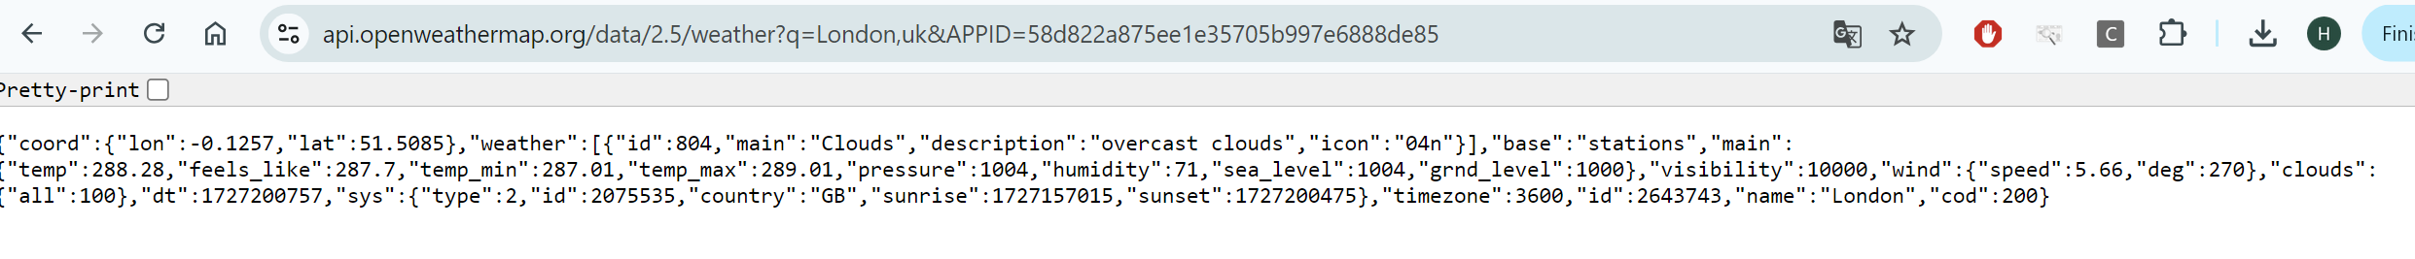
Openweather API
Get API key

Slide 7
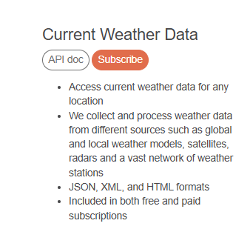
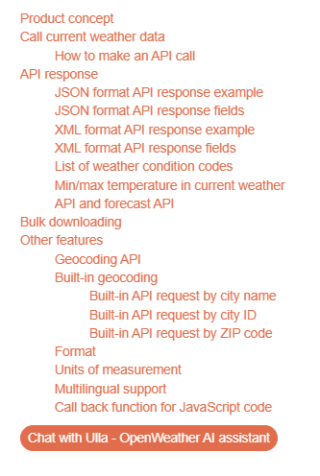
Openweather API

Slide 8
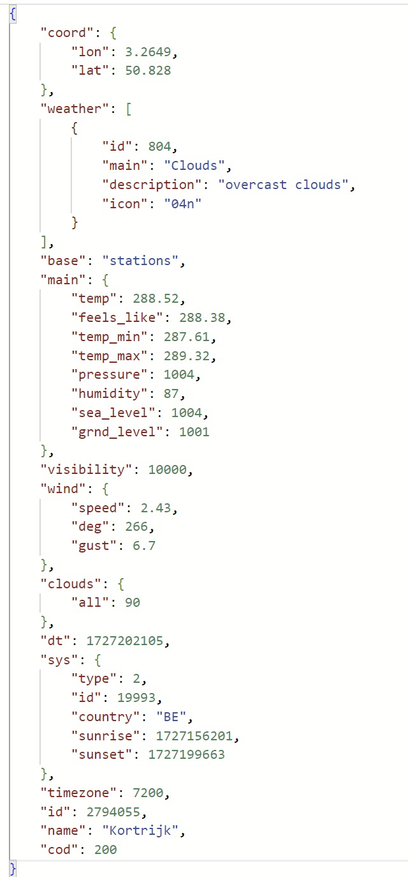
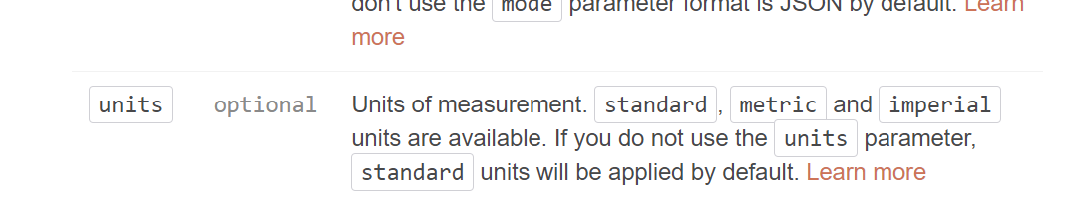
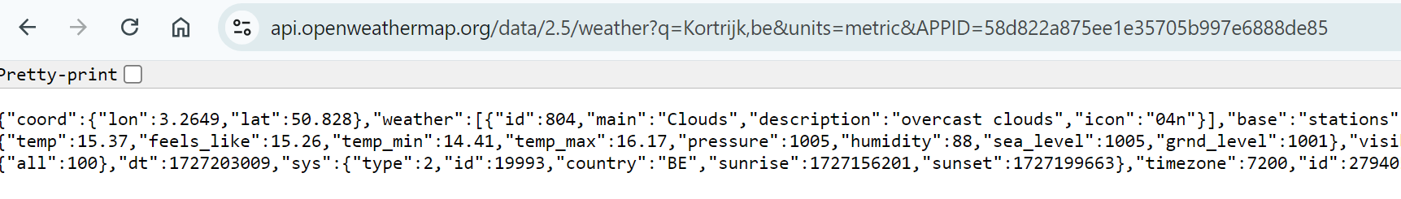
JSON object
Sunrise and sunset time
Temperature in Kelvin
=> oplossen in Node-RED with function block
=> API lezen

Slide 9
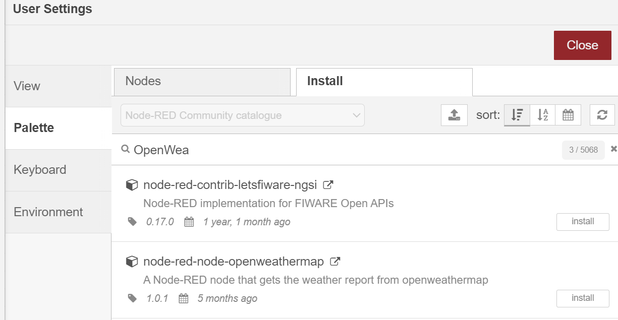
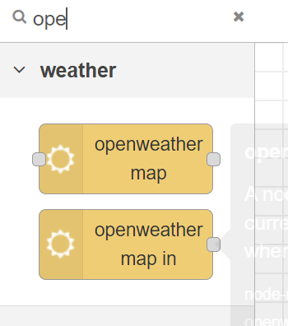
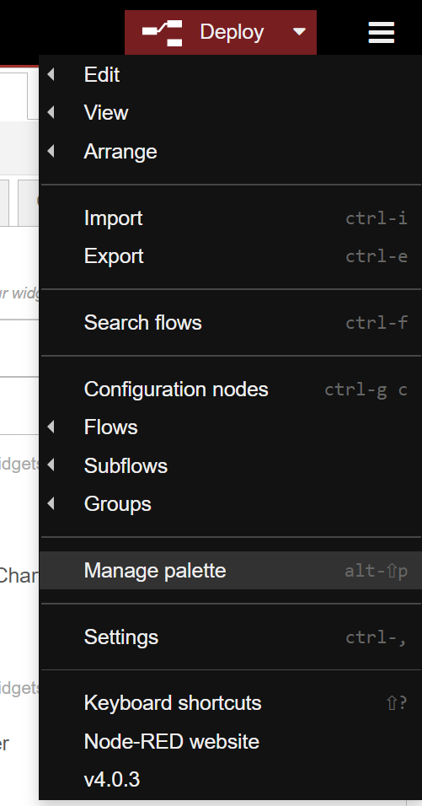
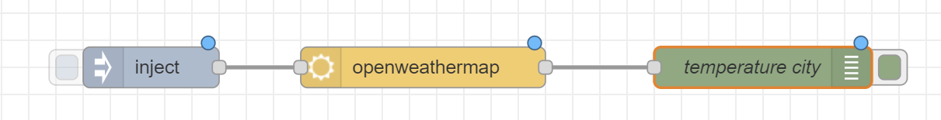
Node-RED => OpenWeather
Manage Palette

Slide 10
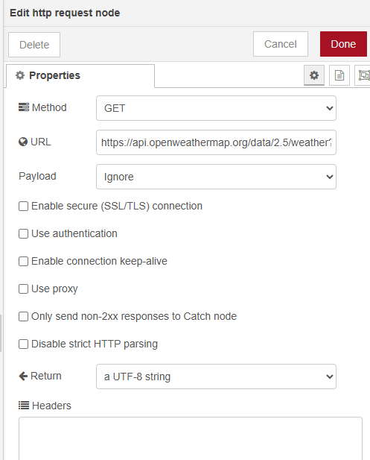
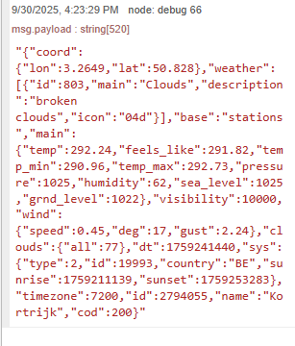
http request

Slide 11
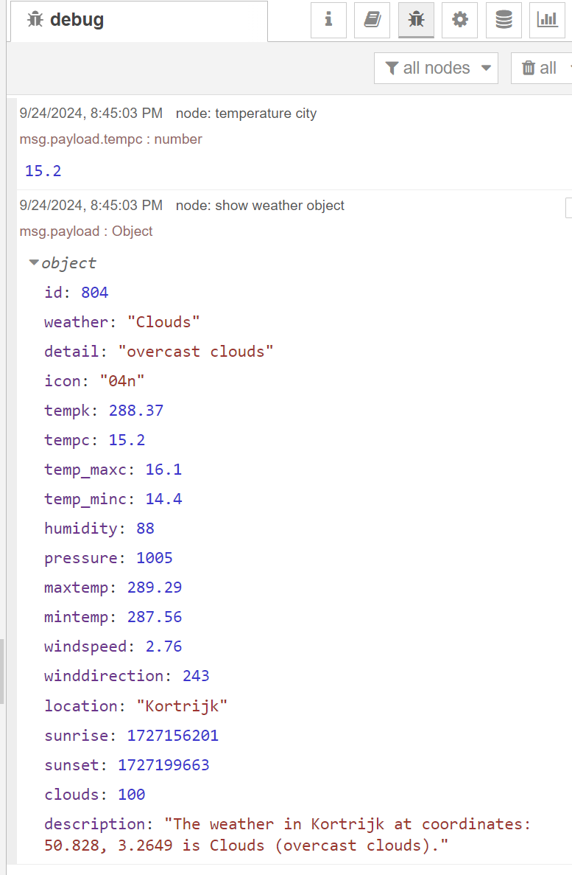
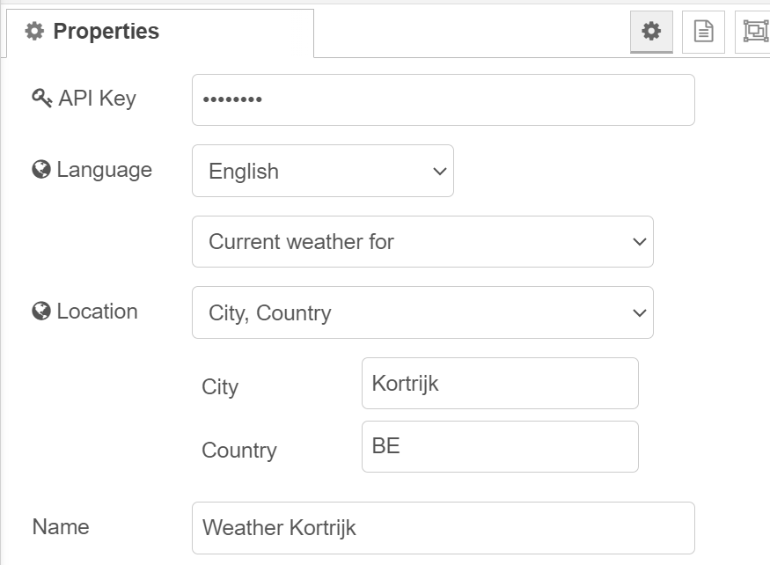
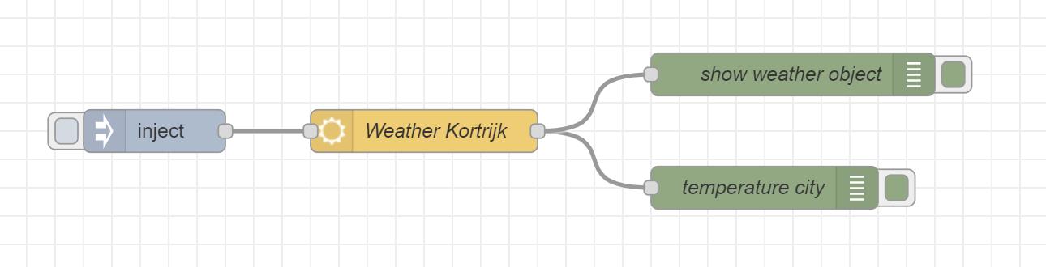
OpenWeather Node

Slide 12
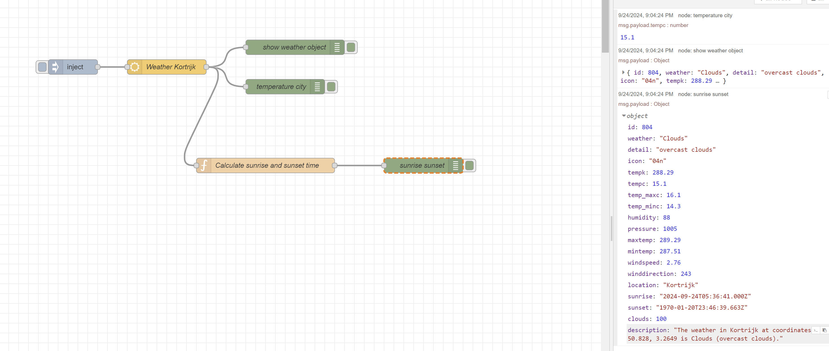
Parse unix time
Tip: google Javascript parse Unixtime

Slide 13
Exercise
Write a function to convert the minimum and maximum temperature
Write a function to determine the winddirection.
Show the sunset and sunrise data in a dateformat
Calculate wind directions east, west, north and south

Slide 14
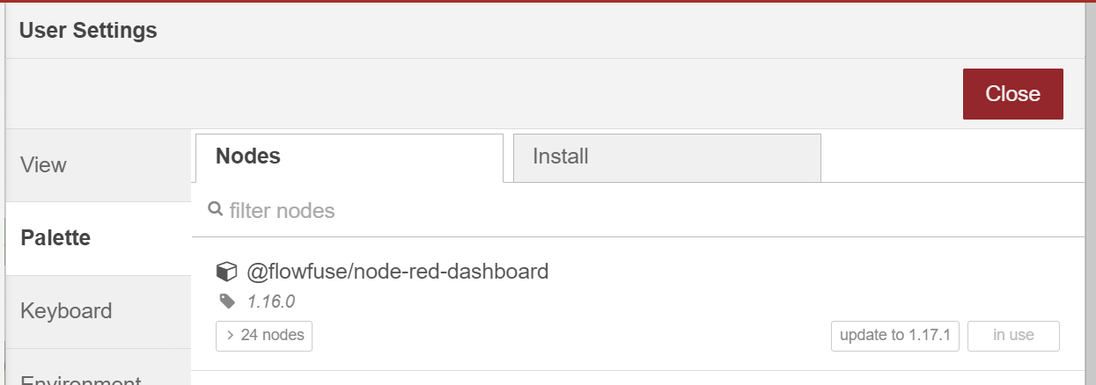
Dashboarding in Node-RED
Node-RED dashboard 2.0 => successor of node-RED dashboard(Angular)
Formed by FlowFuse => complete new project
Manage palette => @flowfuse/node-red-dashboard

Slide 15
Dashboard Hierarchy
Each Dashboard is a collection of widgets (e.g. charts, buttons, forms) that can be configured and arranged in our own User Interface.
The hierarchy of a Dashboard is as follows:
Base - Defines the base URL (e.g. /dashboard) for your Dashboard.
Page - A given page that a visitor can navigate to, URL will extend the base, e.g. /dashboard/page1.
Group - A collection of widgets. Rendered onto a page.
Widget - A single widget (e.g. chart, button, form) created in Dashboard.

Slide 16
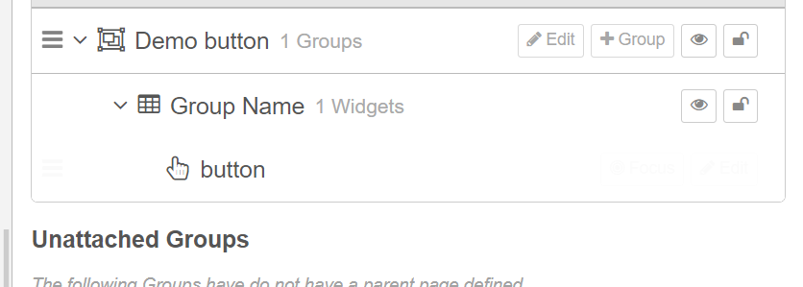
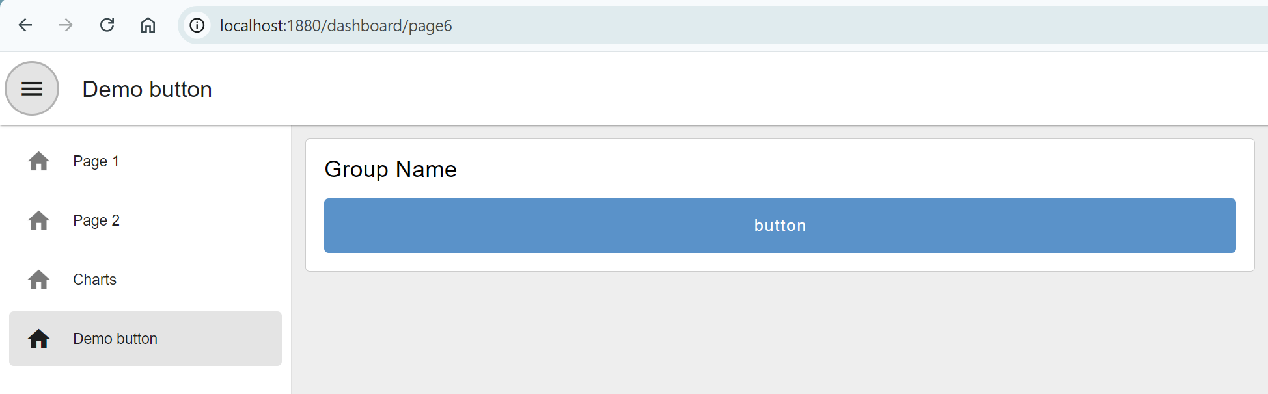
Adding your first widgets
In this case, we drop in a ui-button, click "Deploy" and then can see the button running live in our user interface.
Notice too that Dashboard will automatically create a new group, page, theme and base Dashboard for you.

Slide 17
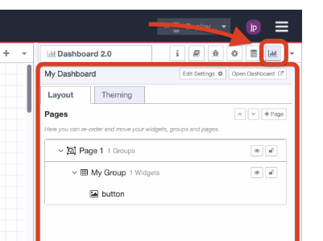
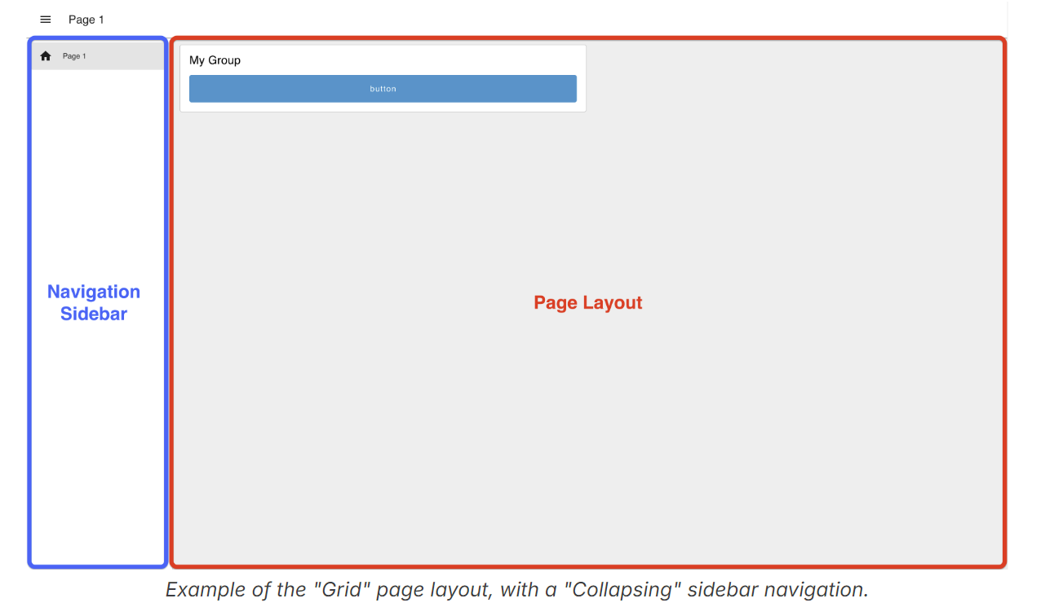
Configuring layout
This sidebar provides an interface by which to view of your pages, themes, groups and widgets. From here you can add new pages and groups, modify existing settings, and re-order content to your liking.
Page Layout: Controls how the ui-groups's are presented on a given page in your application.
Navigation Sidebar: Defines the left-side navigation style, defined at the ui-base level.

Slide 18
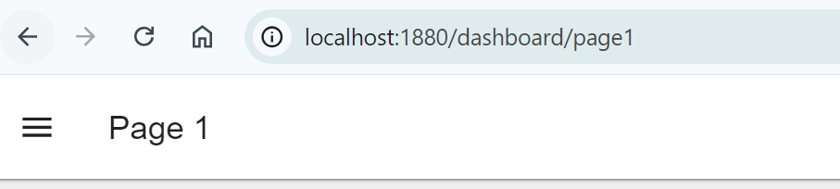
Default page
Each page in Dashboard 2.0 has a unique URL. If a user navigates to an unrecognised path, underneath the /dashboard/ path, then a default page is used to fall back to.
Currently, in Dashboard 2.0, the default page is chosen as the page ordered first in the list of pages in the side navigation

Slide 19
Layout options
Grid: The default layout for a page. It uses a 12-column grid structure to layout the groups. The widths of each group or widget defines the number of columns they will render in. So, a "width" of 6" would render to 50% of the screen. Grid layouts are entirely responsive, and will adjust to the size of the screen.
Fixed: Each component will render at a fixed width, no matter what the screen size is.
Notebook: This layout will stretch to 100% width, up to a maximum width of 1024px. It's particularly useful for storytelling (e.g. articles/blogs).
Tabs: This layout organizes content into separate tabbed sections, allowing users to switch between different views or content categories without leaving the page.

Slide 20
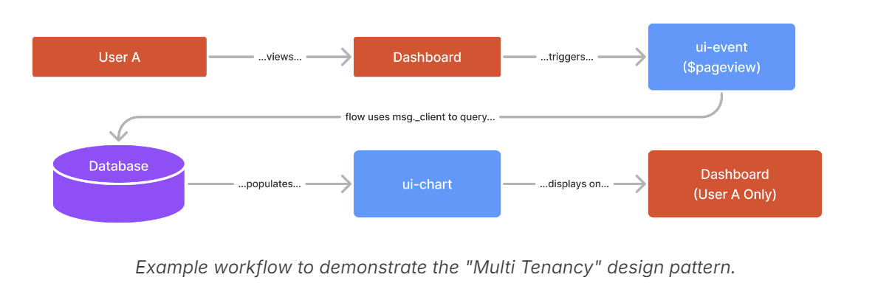
Design patterns
Single Source of Truth: All users of your Dashboard will see the same data. This is useful for industrial IoT or Home Automation applications.
Multi Tenancy: Data shown in a particular widget is unique to a given client/session/user. This represents a more traditional web application, where each user has their own session and associated data.

Slide 21
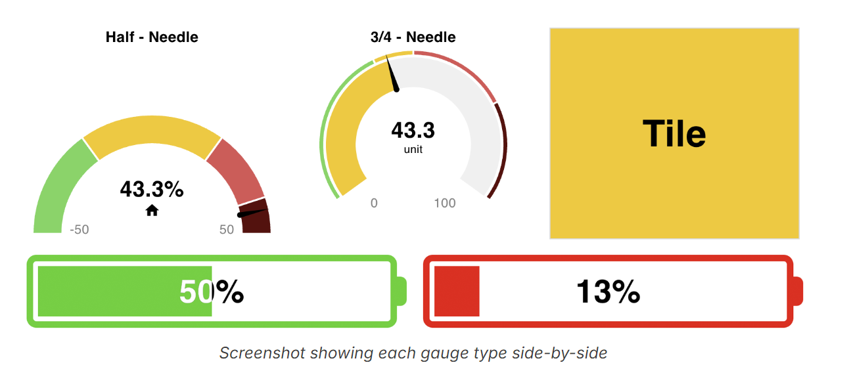
Gauge
Values for the gauges can be set by sending a numerical value in msg.payload. The gauge will then update to reflect this value.

Slide 22
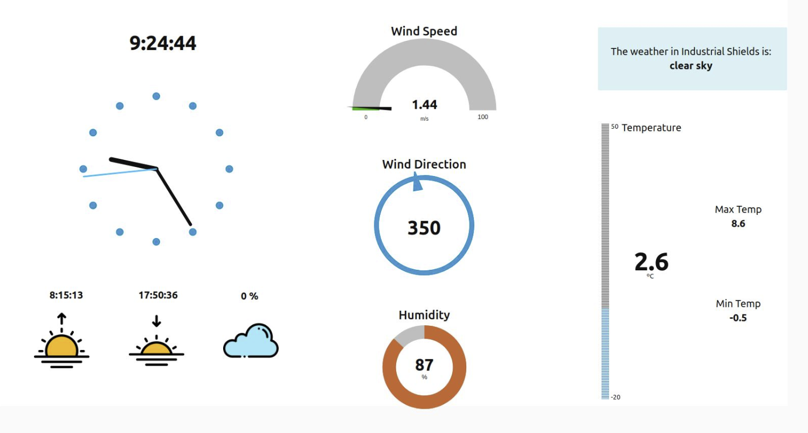
Exercise
Create a dashboard with the weather of a city.
Show the temperature, winddirection, …
Use a gauge, text, chart,…

Slide 23
Sources
https://nodered.org/
https://nodered.org/docs/tutorials/
https://noderedguide.com/
https://dashboard.flowfuse.com/

